Slide 1
Drilling the Earth’s Past
Team #notacircle + Rebecca Greenberger
AMNH Hackathon 2019: Hack the Solar System

Slide 2
Two tasks:
Automatically detect “veins” in images of ophiolite rock slices
Classify minerals in ophiolite rock slices at a pixel level based on reflectance spectra

Slide 3
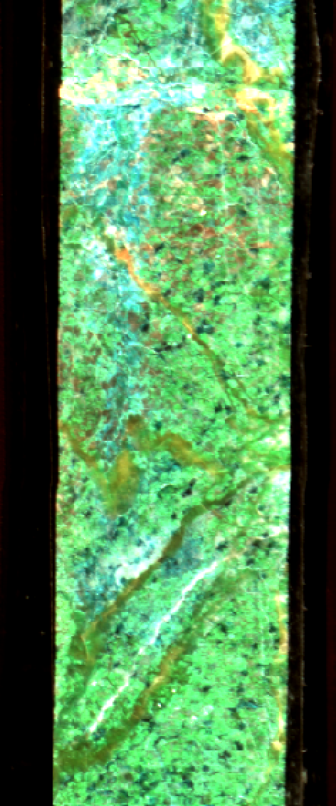
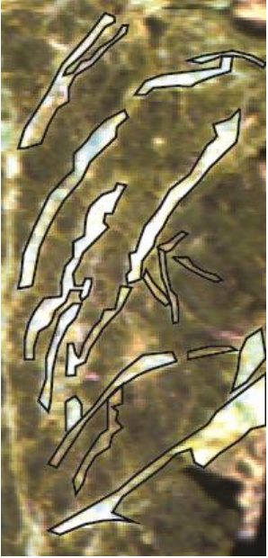
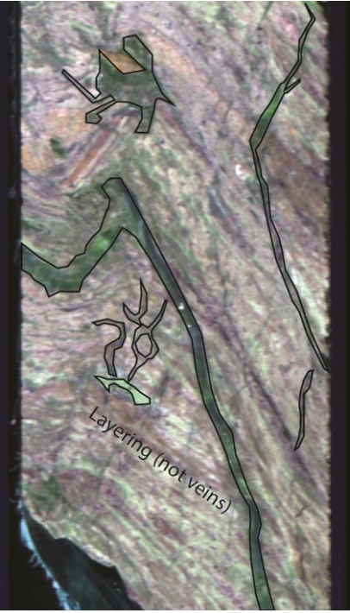
Solution 1: Automatically Identify Mineral Veins
Notes:
Example vein regions shown in white on the left and black in the middle — can be difficult to distinguish btwn veins and other rock features like banding & foliation

Slide 4

Notes:
displayHDRImage: given a stack of 257 image bands from different wavelengths:
get rid of wv regions with a lot of wv noise <1000 & >2540
run through cleaned dataset to render all pixel reflectance values for each wavelength layers
What went right:
Read the image & converts to greyscale
Blurred the greyscale images using GaussianBlur via some values
Created a temporary threshold image based on some threshold values to get rid of reflectance noise (guess @ where the contour lines would be) (this needs tweeking)
Generated contour values around these threshold perimeters
Before the final contour drawings are generated, PCA is used: https://docs.opencv.org/3.4.3/d1/dee/tutorial_introduction_to_pca.html to determine if the contour graphs themselves have a "strong" linear dataset
A new image is produced where the contour drawings should wrap around the veins on each band.

Slide 5
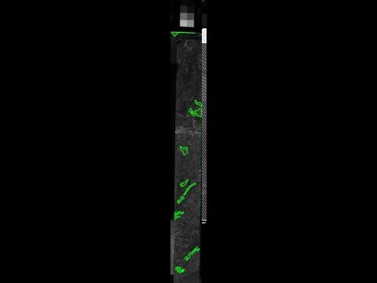
Notes:
What went wrong:
No verification that we have captured all the veins present in an image
May be identifying some non-vein rock features as veins. Could use a few iterations of verification by a trained eye and refining the PCA
Future additions:
Would be good to create a confidence interval/estimate of how accurately a vein has been ID’d
The contour drawings should be weighed against all the other bands to determine definitively if there is a vein throughout the image file.
Mark the locations in each wavelength slice where the PCA identifies a vein. Compare these locations across the entire image stack, and the places where there are more locations piled on top of one another would be more likely to be a vein/is a more clearly-identified vein

Slide 6
Solution 2: Classify Mineral Spectra
Desired outcome
Input: image
Output: mineral + score for each pixel
Problem: no labeled data
Choose to use an unsupervised approach and ask Rebecca to manually label 20 images as a small validation set

Slide 7
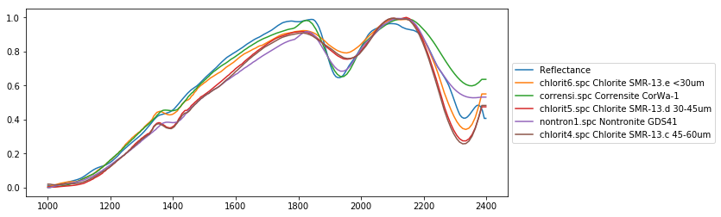
Solution 2: Classify Mineral Spectra
Methodology
Preprocess
Remove 1000 < wavelengths < 2400
Normalize
Smooth
Classify
Collaborative filtering using Pearson ρ
Validate results using 20 samples we asked our stakeholder to label
Normalized
Reflectance
Wavelength (micrometers)

Slide 8
Solution 2: Classify Mineral Spectra
Example result for one pixel:
Rebecca thought this was Chlorite
Our model ranked Chlorite, Corrensite, Nontronite as the highest similarity to the pixel spectrum
Normalized
Reflectance
Wavelength (micrometers)

Slide 9
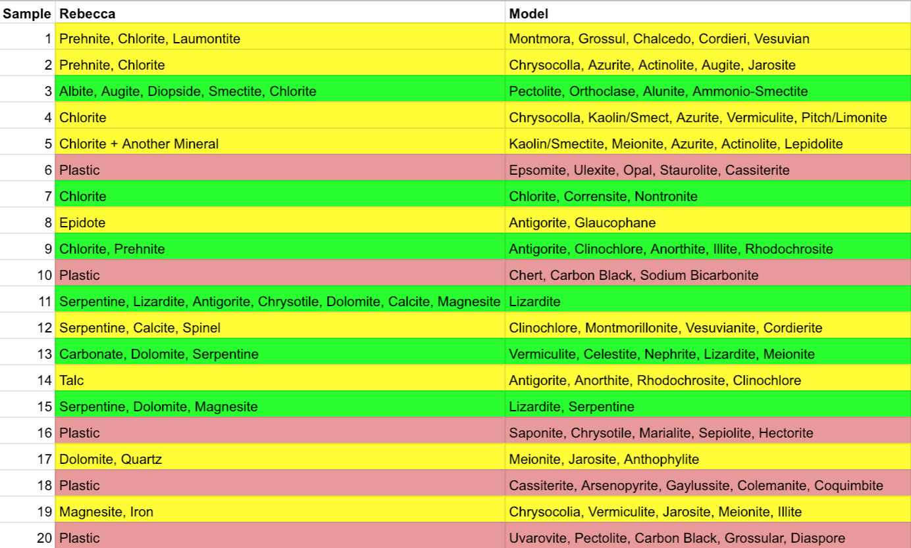
Solution 2: Classify Mineral Spectra
Validation set results (Green: correct, Yellow: unsure, Red: wrong):

Slide 10
Thank you!

